Slide 1
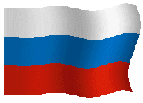









R U S S I A
R U S S I A
R U S S I A
( SUMMARY )

Slide 2
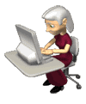

T a s k s
Attentively read all the facts about each item of the plan ( one by one).
If you don’t understand any word or expression look up into a dictionary.
While looking at a slide try to tell about the facts on it with your own words; make up sentences with all the expressions on each slide.
Then return to the beginning and try to speak fluently about each item of the plan with the help of key words and pictures of every slide .
At last try to speak about Russia as you like imagine that you are telling about your Motherland to a foreign tourist .
GOOD LUCK!

Slide 3
Facts About Russia
Official name | The Russian Federation
Capital | Moscow
Official language | Russian
Population | 143,000,000 people
Rank among countries in population | 8th
Major cities | Moscow, St. Petersburg, Nizhniy Novgorod
Area | 6,590,000 square miles 17,100,000 square kilometers
Rank among countries in area | 1st
Highest point | Elbrus 18,510 feet/5,642 meters
Currency | Ruble

Slide 4
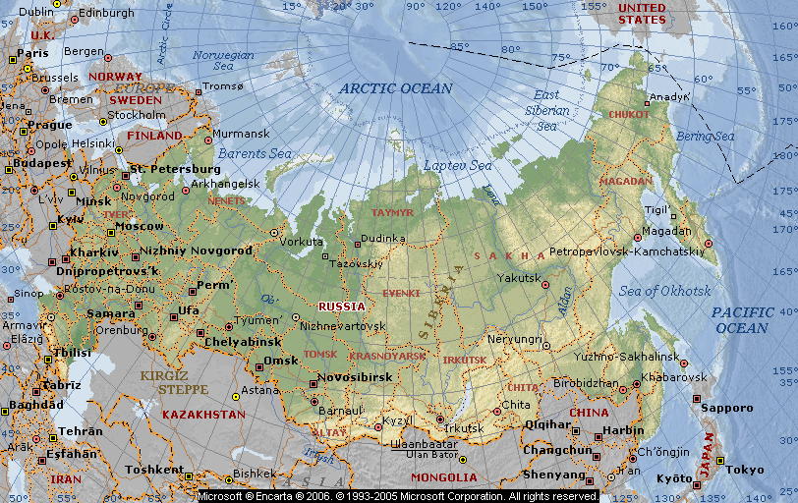
Russia or Russian Federation, an independent country officially known as the Russian Federation (in Russian, Rossiyskaya Federatsiya). By far the world’s largest country, Russia is almost twice the size of the next largest country, Canada. Russia sprawls across eastern Europe and northern Asia.

Slide 5
People of Russia
Population | 143,420,310 (2012 estimate)
Population density | 8.4 persons per sq km 22 persons per sq mi (2012 estimate)
Urban population distribution | 73 percent (2012 estimate)
Rural population distribution | 27 percent (2012)estimate)
Largest cities, with population | Moscow, 11,514,300 (2012) St. Petersburg, 5,227,567 (2012) Novosibirsk, 1,473,737(2012)
Official language | Russian
Chief religious affiliations | Orthodox (Russian) Christian, 79 percent Muslim, Atheist
Life expectancy | 67.1 years (2012 estimate)
Literacy rate | 99.6 percent (2012 estimate)

Slide 6
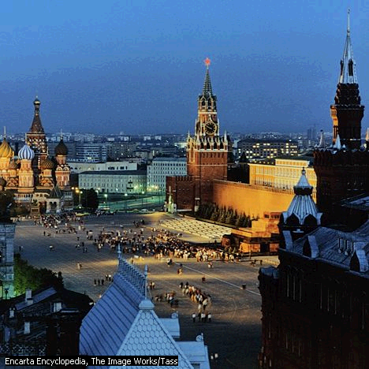
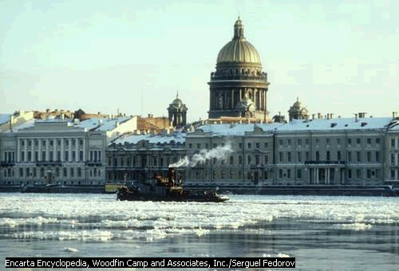
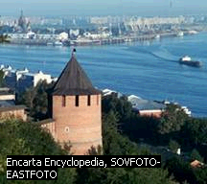
Largest cities
Moscow, St. Petersburg, Novosibirsk, Ekaterinburg, Nizhniy Novgorod, Omsk, Ufa
St. Petersburg
Moscow
Nizhniy Novgorod

Slide 7
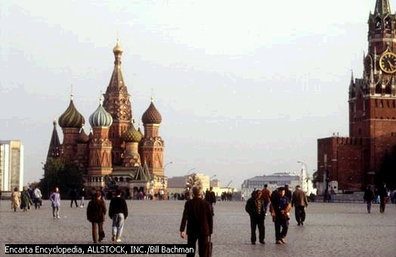
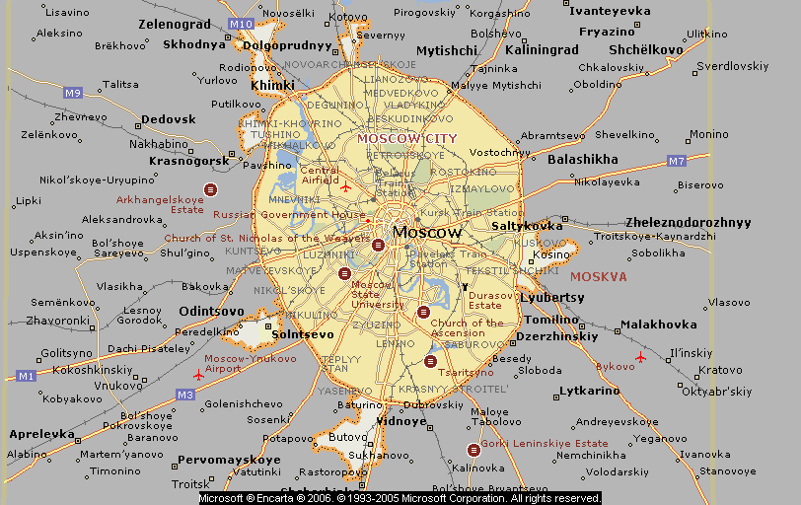
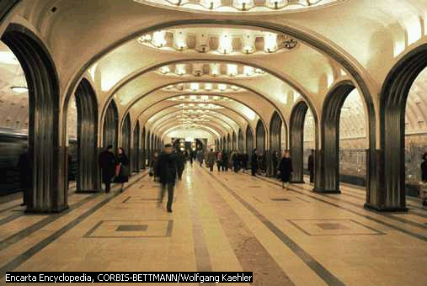
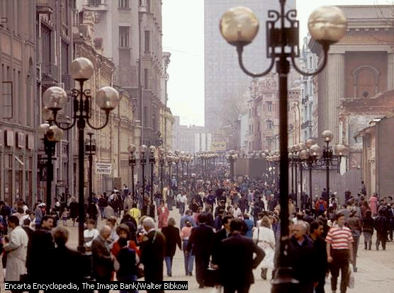
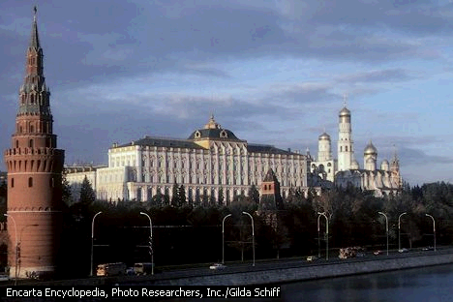
MOSCOW
Moscow (city, Russia) (Russian Moskva), capital and largest city of Russia, capital of Moscow Oblast, and the country’s leading political, cultural, economic, and transportation center. Moscow lies on the Moscow River in the west central European part of Russia.
Red Square, Moscow
Moscow Metro
Arbat Street
Great Kremlin Palace

Slide 8
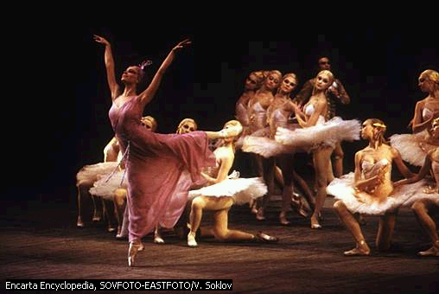
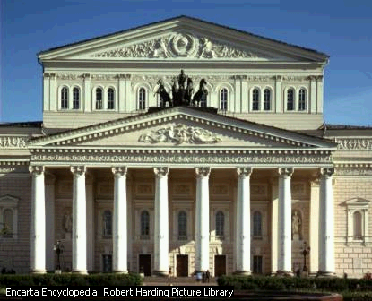
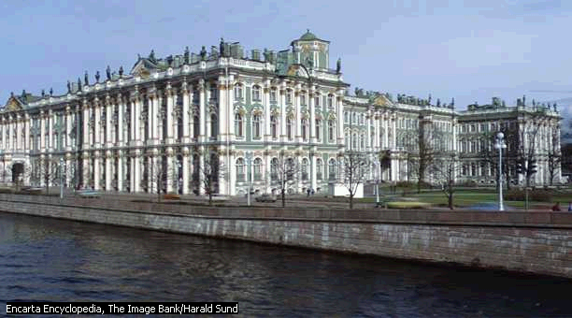
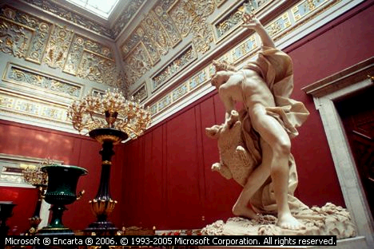
Cultural Institutions
Russia has a long tradition of excellence in ballet.
State Hermitage Museum

Slide 9
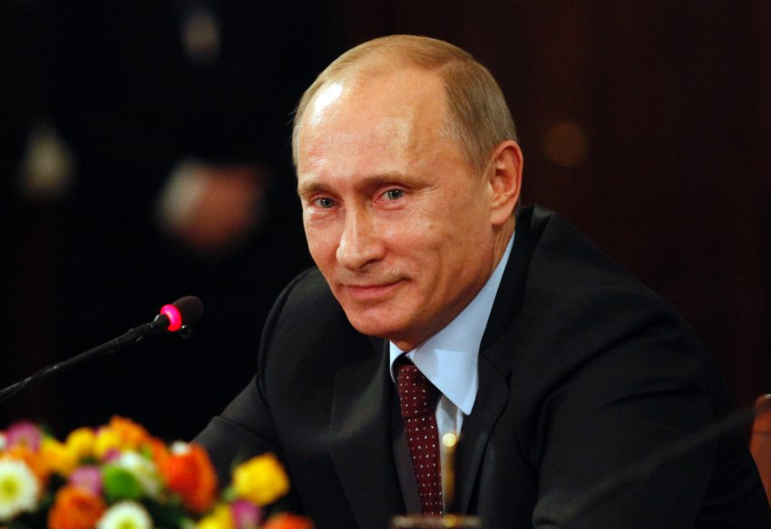
Government of Russia
Form of government
Federal republic
Head of state
President
Head of government
Prime minister
Legislature
Bicameral legislature (Federal Assembly):
Council of the Federation, 178 members
State Duma, 450 members
Voting qualifications
Universal at age 18
Constitution
12 December 1993
Highest court
Constitutional Court
Acting Russian president
Vladimir Putin

Slide 10
HISTORY
AD 862 According to early chronicles, Rurik, a Viking chieftain, assumed control of Slavic kingdoms that came to be known as "Land of the Rus."
about 988
Grand Prince Vladimir I of Kiev converted to Christianity, and the new religion soon spread to other Russian principalities.
1240
Mongol armies sacked Kiev and Russia became a part of the Mongol Empire called the Golden Horde.
1613
Michael Romanov was elected czar, ending the Time of Troubles and beginning over 300 years of Romanov rule of Russia.
1689
Peter I (later known as Peter the Great) assumed full power as czar and began transforming Russia into a world power.
1812 Napoleon I of France invaded Russia and advanced as far as Moscow, but eventually was forced to retreat.
1917
A popular revolution removed the czar from power.
1941- 1945 Great Patriotic War
1991. Russia then became an independent nation. - The Russian Federation.

Slide 11
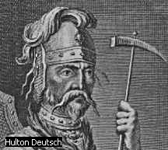
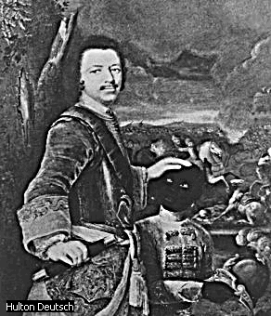
Ryurik, Founder of Russia
Ryurik, a semimythical Scandinavian chief, is credited with consolidating the Eastern Slav tribes around Novgorod into a single state in 862. From the Scandinavians, called Varangians or Rus, came the name Rossiya, or Russia, meaning the country of the Rus.
.
Peter the Great
Peter the Great (Peter I) brought Western culture to Russia, built roads and canals, modernized the army and navy, and secured seaports for trade. By doing so, Peter realized his goal of turning Russia into a great world power.
The Second World War caught up 61 countries and 80 percent of the Earth’s population.
For people of the Soviet Union it was the Great Patriotic War (1941-1945).
They lost tens of millions of citizens defending freedom of their own country and liberating peoples of Europe from the Nazis invaders.

