Slide 1
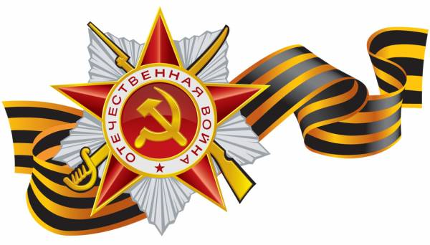
World War II
QUIZ
Митюгина Татьяна Геннадьевна учитель английского языка
МБОУ - Кокинская СОШ Брянской области

Slide 2
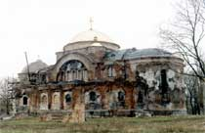
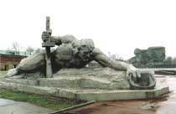
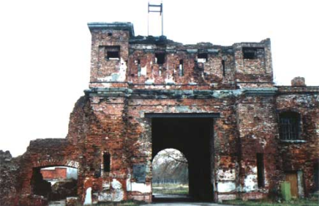



Legendary Fortress
1
a)Sevastopol
b)Brest
c)Stalingrad
a
b
c

Slide 3
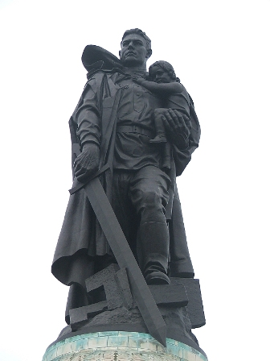
Where is this monument?
2
in Moscow
in Volgograd
in Berlin
a
b
c

Slide 4
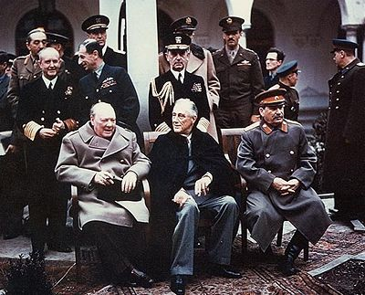
Iosif Vissarionovich Stalin
3
Leaders of the USA – Franklin Roosevelt, Great Britain – Winston Churchill and of the USSR – I.V.Stalin in Yalta, 1945.
a b c
a
b
c

Slide 5
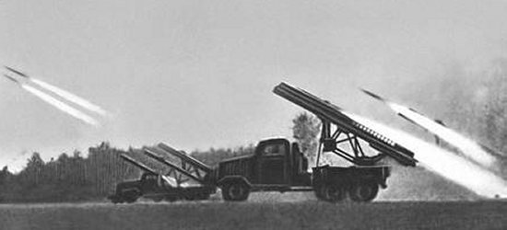
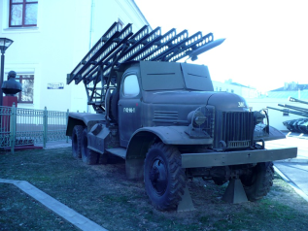
Famous Russian rocket launcher
4
Marisha
Natasha
Katyusha
a
b
c

Slide 6
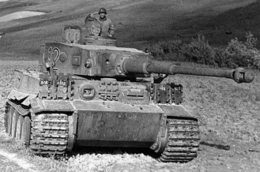
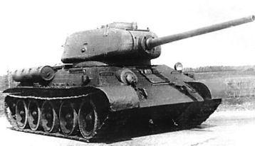
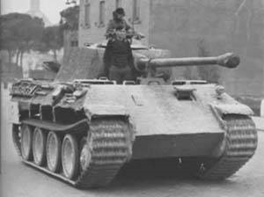
Which tank was the best ?
5
Tiger
Т- 34
Pantera
a
b
c

Slide 7
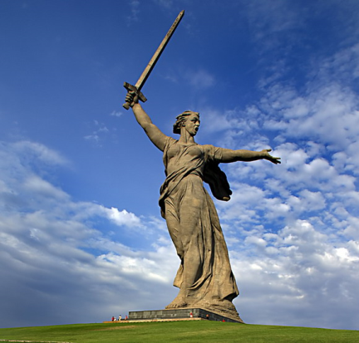
The Motherland Calls
6
The monument commemorates…
the battle of Stalingrad
the battle of Moscow
the battle of Leningrad
a
b
c

Slide 8
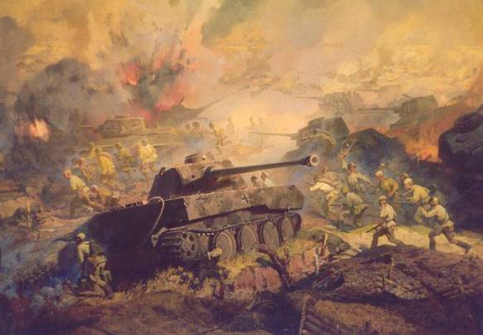
The biggest tank battle
7
The battle of …
Kursk
Stalingrad
Moscow
a
b
c

Slide 9
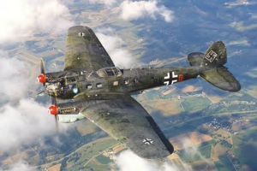
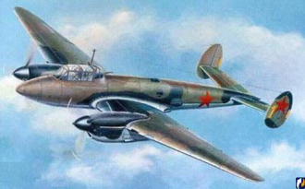
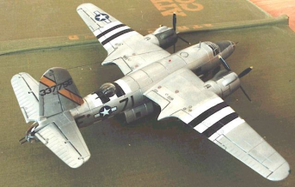
Bombers of the World War II
8
a
Which of them is German?
b
c
a
b
c

Slide 10
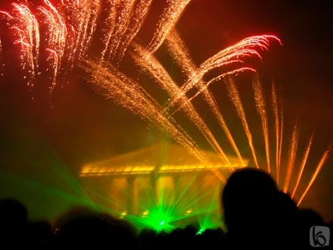
First Salute
9
The first War salute was ….
in 1945
in 1944
in 1943
a
b
c

Slide 11
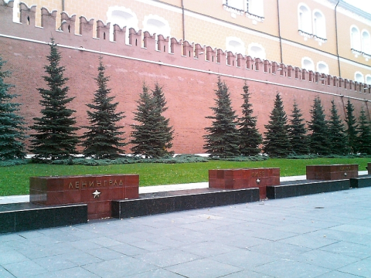
Hero Cities
10
How many cites were awarded the title of the Hero City?
10
13
14
a
b
c

Slide 12
Использованные ресурсы:
http://lugansk.proua.com/country/2009/05/08/174348.html
http://www.fedpress.ru/52/socium/sochi2014/id_97634.html
http://old.bratstvo.info/rus/comments/08050501.shtml
http://www.fictionbook.ru/ru/author/gitler_adolf
http://historyworlds.ru/index.php?do=gallery&act=2&cid=135&fid=4147
http://www.carstock.ru/Dictionary/%D0%A8%D1%82%D1%83%D1%80%D0%BC%D1%82%D0%B8%D0%B3%D1%80
http://www.reichstag.su/news/70
Репродукция картины: Вагн Тюрстед Расмуссен, Дания
http://gunter-spb.livejournal.com/130327.html
http://news.flexcom.ru/world/2003/07/11/17463/
http://www.bg-znanie.ru/rubrics.php?r_id=2647
http://modelism.airforce.ru/reviews/foreign/b-26/
http://ru.wikipedia.org/wiki/%D0%A4%D0%B0%D0%B9%D0%BB:City_Hero_Moscow.jpg
http://en.wikipedia.org/wiki/The_Motherland_Calls

