Slide 1


Slide 2

1. Create a phrase:
a/ make up the word
from the letters
i
v
e
l

Slide 3
b/ count, and write the answers:
Zero + one =
2. Three + eleven =
3.(Eighty nine – eighty one): two =
Your answers will help you to write
the second word of the phrase:
Example: 12+7=19 - S

Slide 4
c/ Choose the end of the phrase:
smile
sleep
learn
get knowledge
be happy
Write down the whole phrase

Slide 5

2. Match:
New year’s Day
St. Valentine’s Day
Easter Festival
Guy Fawkes’ Night
Halloween
Christmas
31 of October
25 of December
1 of January
14 of February
5 of November
March or April

Slide 6

3. Match:
tasty
favorite
sunbathe
change
decorate
prepare
загорать
украшать
готовить
менять
любимый
вкусный

Slide 7
4. Translate into English:
настоящий друг
разные культуры
высокий голос
свежие фрукты
кататься на лыжах
мыть посуду
завтракать
глупый страус
храбрый заяц
встретить ежа

Slide 8

5.Find a pair to the word:
famous
job
woman
painter
hill
work
girl
mountain
brush
well-known

Slide 9

6. Make up the words:
okec
dalsa
eeffoc
oups
oraegn
zzapi
7. sawindch
8. burghamer
9. cholacote
10. cbgabae
11. tun
12. yheno

Slide 10

7. What can you eat?
cake
fish
orange
chalk
sofa
doll
salad
apple
puzzle
fur

Slide 11
8. What things can you wear?
fur coat
sweet
skirt
flower
raincoat
6. trousers
7. brothers
8. mittens
9. kittens
10. suit

Slide 12
9. What can help you to study?
daybook
glue
flu
bush
bird
sharpener
folk
fox
pencil box
felt –tip pen

Slide 13

10. Complete the text.
Use un-, -er, -or, -ly, -y, to form the words.
One day Henry’s __(1)___ decided to take her class to Conway. «There is an__(2)__ castle there», she said. «You must get up early». Her pupils were __(3)__ to hear that. The next day the weather was not very __(4)__. It was could and __(5)__. The sun was not shining in the sky because it was__(6)__. The children and other __(7)__ came up to the castle __(8)__. «It’s so nice and old! », said the children __(9)__.
teach
usual
happy
pleasant
wind
cloud
visit
slow
happy

Slide 14

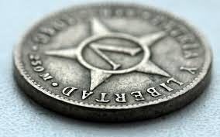
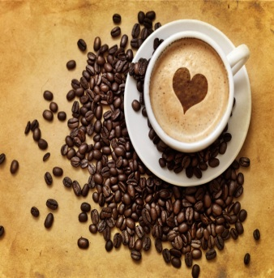

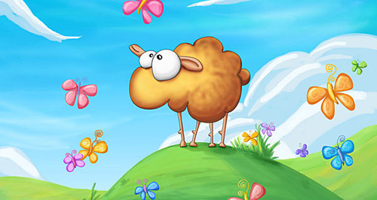
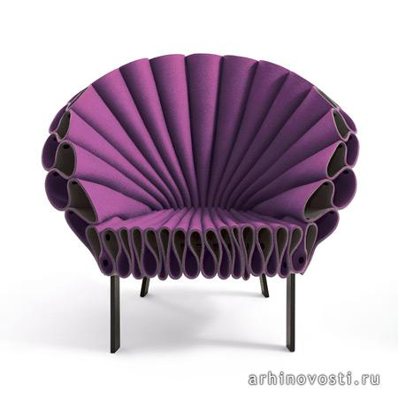
11.Match pictures and words:
1.
2.
3.
4.
5.
a. sheep
b. cousin
c. chair
d. caffe
e. coin
f. watch
g. clock
h. sheeps
i. coffee
g. cheese

Slide 15

12. Complete the words:
_nv_ronm_nt
b_h_vi_r
_nfl__n_e
ad__nt__e
po___t___

Slide 16

13. Add the words:
Mr. Fowles is a __(1)__. He collects __(2)__ and __(3)__ facts about wild birds. For example he is interested in__(4)__ facts related to puffins, very __(5)__ sea birds. Mr. Fowles often goes to one of the islands in the North Sea to study the __(6)__ of puffins living there. He knows a lot about these birds: the __(7)__ and __(8)__ of their wings, the number of chicks they have, the birds’ __(9)__ and __(10)__. The local __(11)__ say Mr. Fowles is of great help to them.
population
unusual
scientist
ecologists
width
different
growth
information
interesting
length
development

Slide 17
14. match
useless materials
the place in which people live and work
a scientist who studies the environment and the way plants, animals and people live together in relation to each other
a place usually outside a town where people collect waste
the world with all living things, the land and the seas
to make air, water and soil too dirty and dangerous for people
environment
ecologist
pollute
waste
dump
nature
1.

Slide 18

15. Make up new words:
pronunciation

